Slide 1
CAR RESALE VALUE PREDICTION
PRESENTED BY:
TEAM NO:CSE-005
18UK1A0509 - SAI CHANDANA PALA
18UK1A0525 - KANKATI PRANITA
18UK1A0526 - JADALA KARTHIK
18UK1A0521 - JANGA SPANDANA REDDY

Slide 2
OUTLINE
INTRODUCTION
OBJECTIVE
DATA
MACHINE LEARNING
APPROACHES
VISUALIZATION OF GRAPHS
SOFTWARE REQUIREMENTS
CONCLUSION

Slide 3
INTRODUCTION
In this project we have used different algorithms with different techniques for developing Car resale value prediction systems considering different features of the car. In a nutshell, car resale value prediction helps the user to predict the resale value of the car depending upon various features like kilometers driven, fuel type, etc.

Slide 4
OBJECTIVE
The main objective is to explore what kind of data is provided, determine the most important factors to calculate the accurate price of used cars. we need to create a appropriate model to do so.
Model should consider all the crucial factors which plays a vital role in predicting the resale value of cars with maximum accuracy. To access this model we will develop a simple user interface.

Slide 5
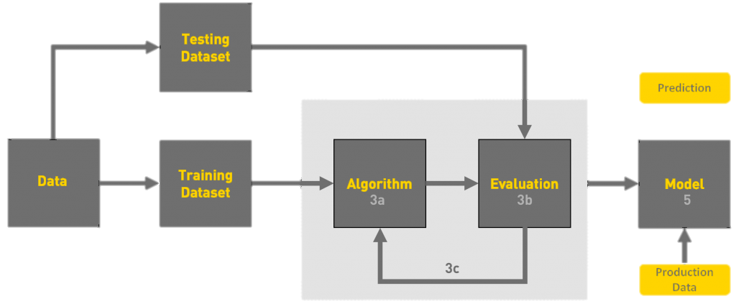
FLOW CHART

Slide 6
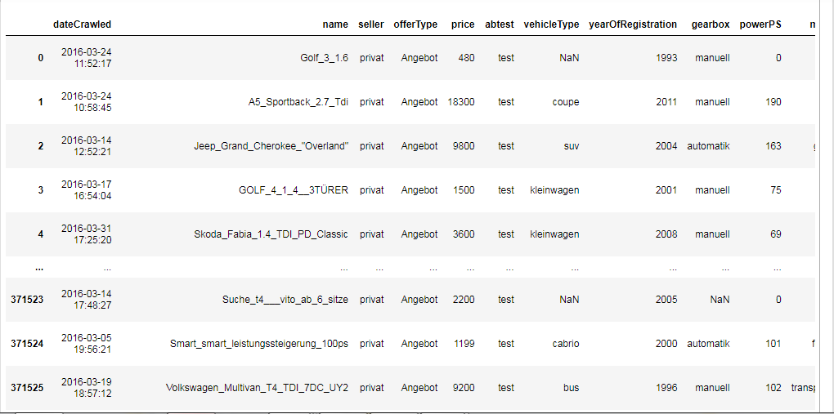
DATA
Prediction and Analyzing Car Resale Values dataset consists of:
371528 rows × 20 columns
'dateCrawled','name', 'seller', 'offerType', 'price', 'abtest', 'vehicleType', 'yearOfRegistration', 'gearbox', 'powerPS', 'model', 'kilometer', 'monthOfRegistration', 'fuelType', 'brand', 'notRepairedDamage', 'dateCreated', 'nrOfPictures', 'postalCode', 'lastSeen‘
Data source: Internet

Slide 7
DATA VISUALISATION
Data visualization is the graphical representation of information and data. By using visual elements like charts, graphs, and maps, data visualization tools provide an accessible way to see and understand trends, outliers, and patterns in data.
In the world of Big Data, data visualization tools and technologies are essential to analyze massive amounts of information and make data-driven decisions.

Slide 8
MODEL BUILDING
There are several Machine learning algorithms to be used depending on the data you are going to process such as images, sound, text, and numerical values. The algorithms that you can choose according to the objective that you might have it may be Classification algorithms are Regression algorithms.
Example:
1.Linear Regression
2.Logistic Regression
3. Random Forest Regression / Classification.
4. Decision Tree Regression / Classification.
You will need to train the datasets to run smoothly and see an incremental improvement in the prediction rate.
On our Dataset , we have applied Random Forest to predict the Accuracy.

Slide 9
MACHINE LEARNING ALGORITHMS
Random Forest :
A random forest is a machine learning technique that’s used to solve regression and classification problems. It utilizes ensemble learning, which is a technique that combines many classifiers to provide solutions to complex problems.
Working of Random Forest Algorithm
Step 1 − First, start with the selection of random samples from a given dataset.
Step 2 − Next, this algorithm will construct a decision tree for every sample. Then it will get the prediction result...
Step 3 − In this step, voting will be performed for every predicted result.
Step 4 − At last, select the most voted prediction result as the final prediction result.

Slide 10
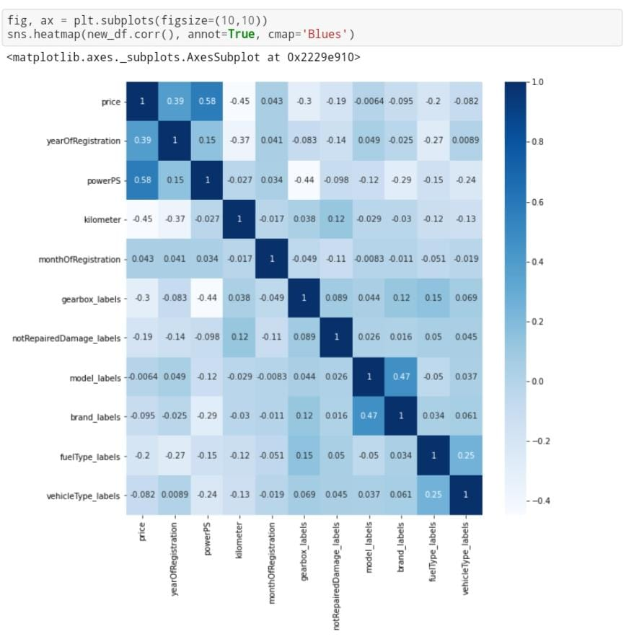
VISUALISATION OF GRAPHS

Slide 11
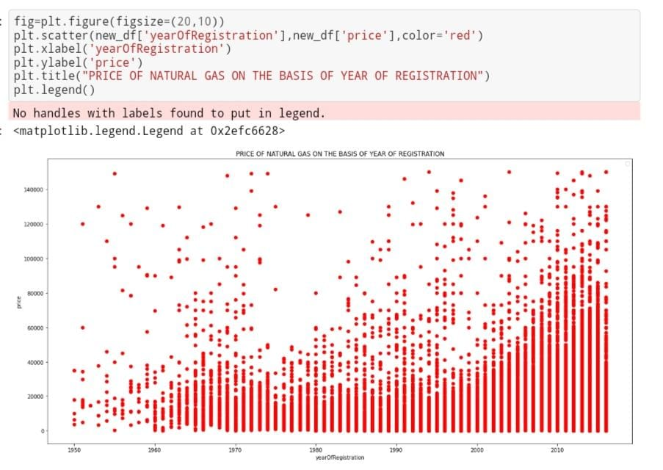
VISUALISATION OF GRAPHS

Slide 12
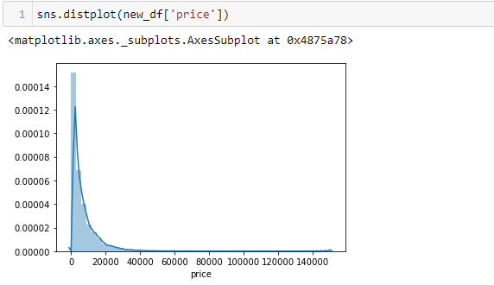
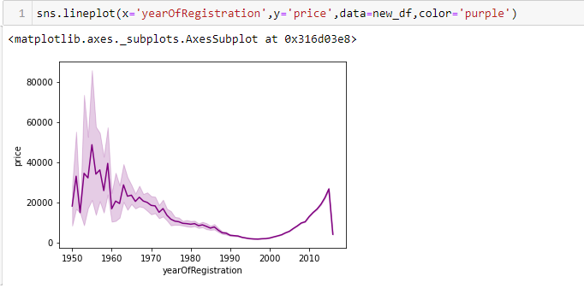
VISUALISATION OF GRAPHS

Slide 13
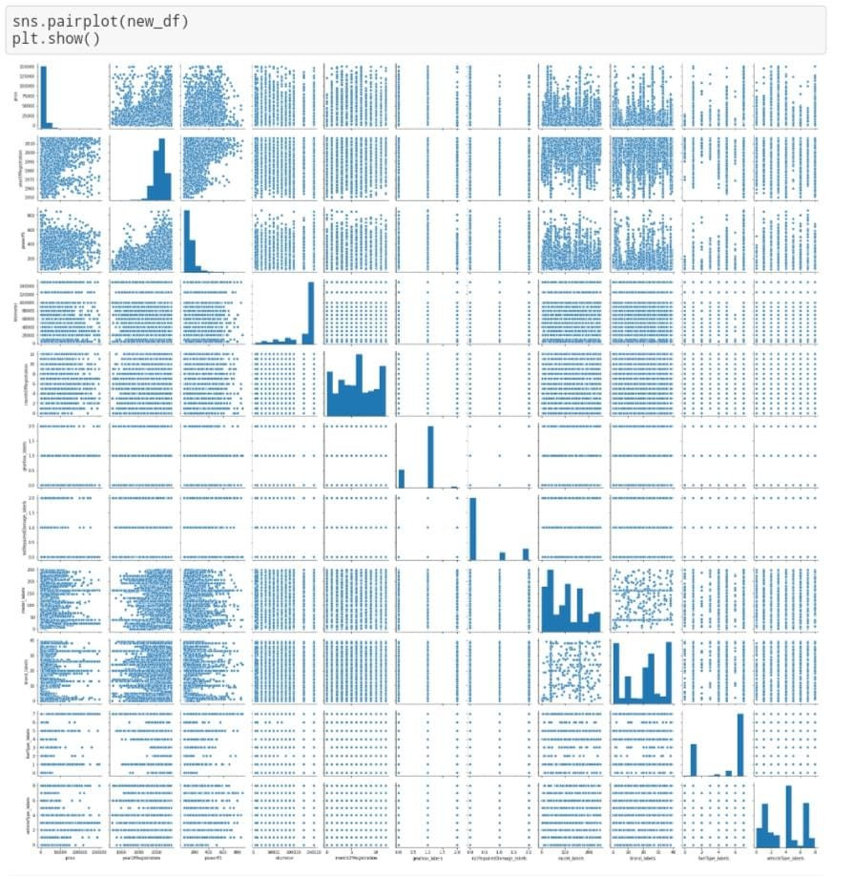
VISUALISATION OF GRAPHS

Slide 14
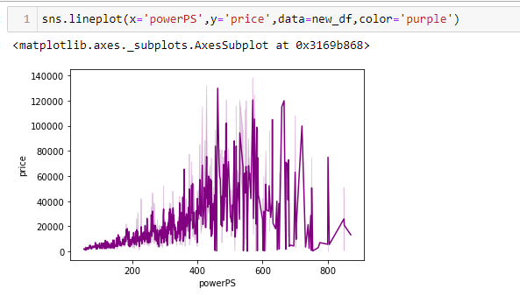
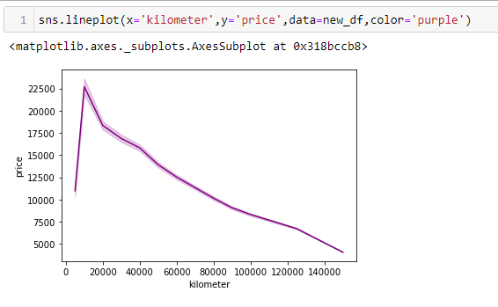
VISUALISATION OF GRAPHS

Slide 15
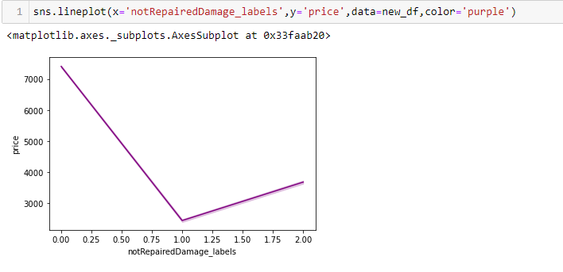
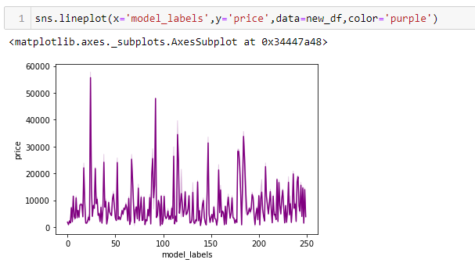
VISUALISATION OF GRAPHS

Slide 16
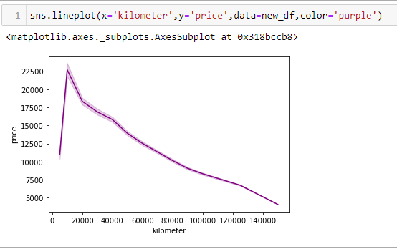
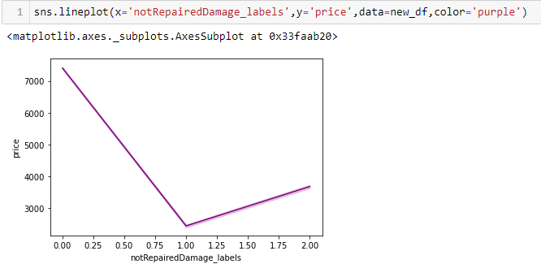
VISUALISATION OF GRAPHS

Slide 17
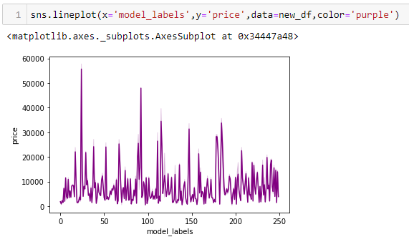
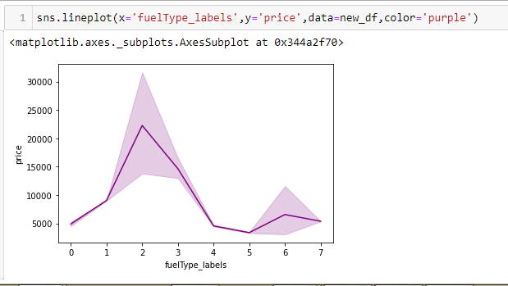
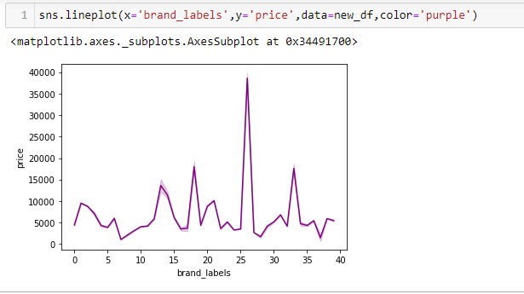
VISUALISATION OF GRAPHS

Slide 18
SOFTWARE REQUIREMENT
Google colab
Anaconda navigator
Jupyter notebook
Machine learning tools: pandas,
NumPy,
Matplotlib,
Scikitlearn,
Seaborn

Slide 19
CONCLUSION
In this project we have calculated average price of an use car depending on different factors.
We have achieved this by using Machine Learning model,
For better results we used Random Forest Algorithm and proved with 83% accuracy,
The main limitation of this study is the low number of records that have been used. As future work, we intend to collect more data and to use more advanced techniques like artificial neural networks, fuzzy logic and genetic algorithms to predict car prices.

